Slide 1
CASE STUDY-TELECOMMUNICATION INDUSTRY
TITLE:-Next Best Offer Recommendation System for Revenue Optimization in Telecommunications

Slide 2

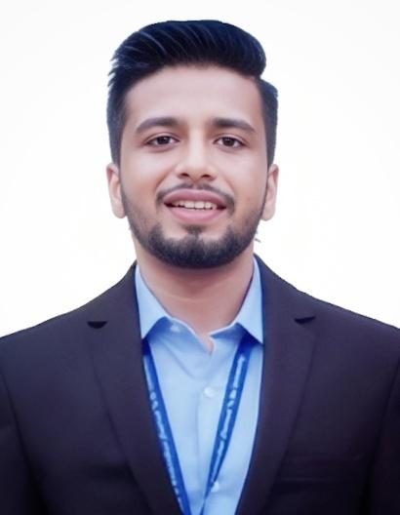
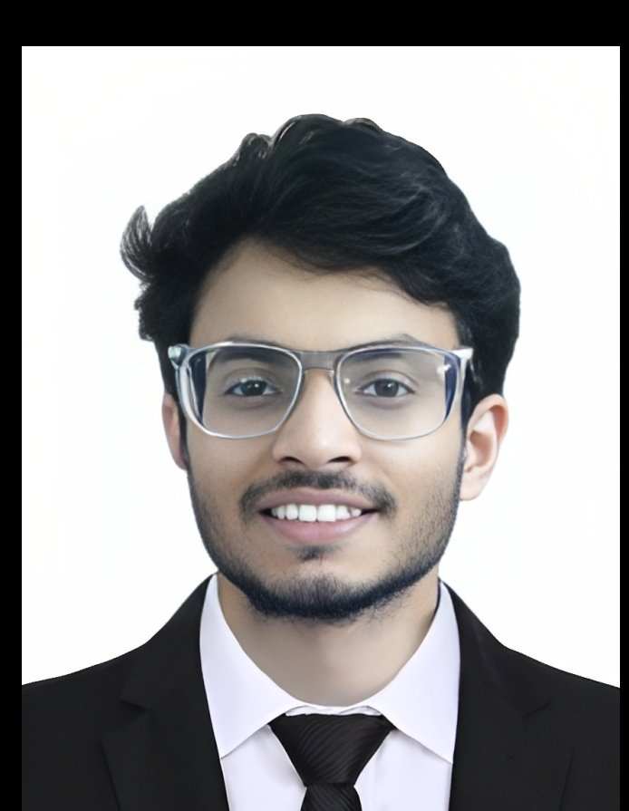
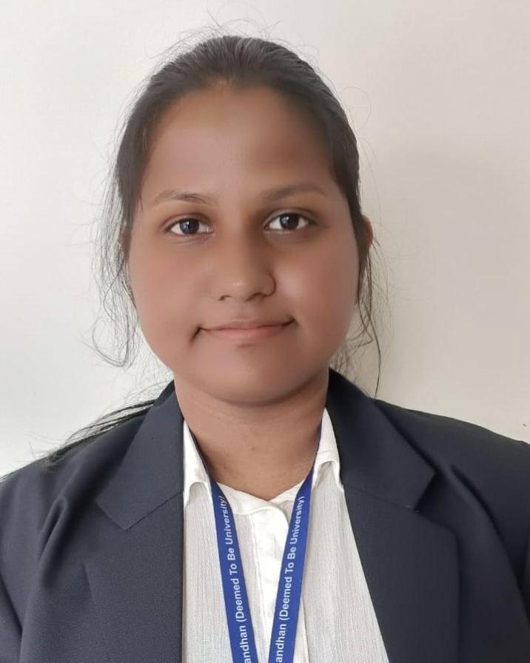
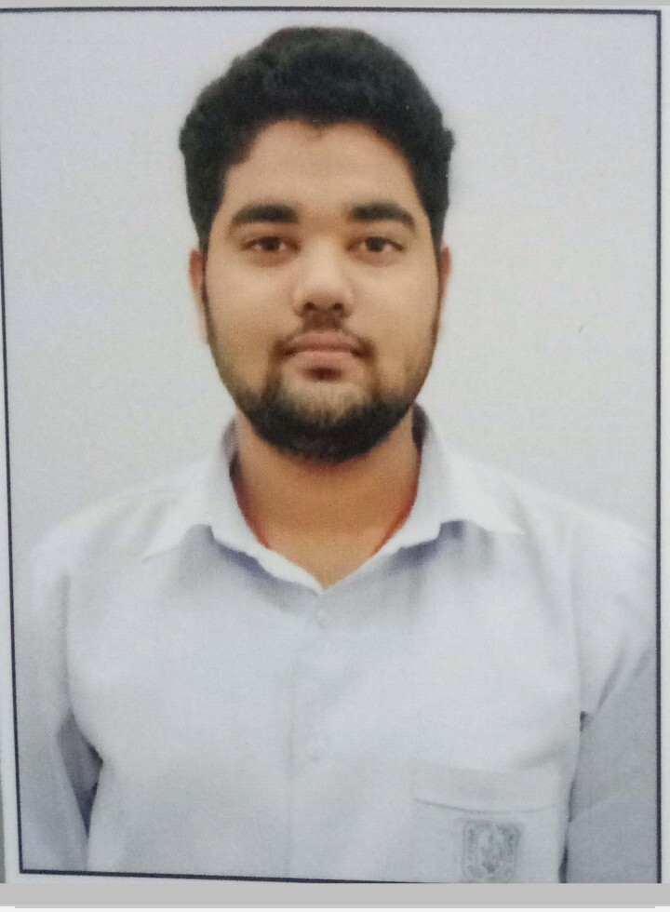
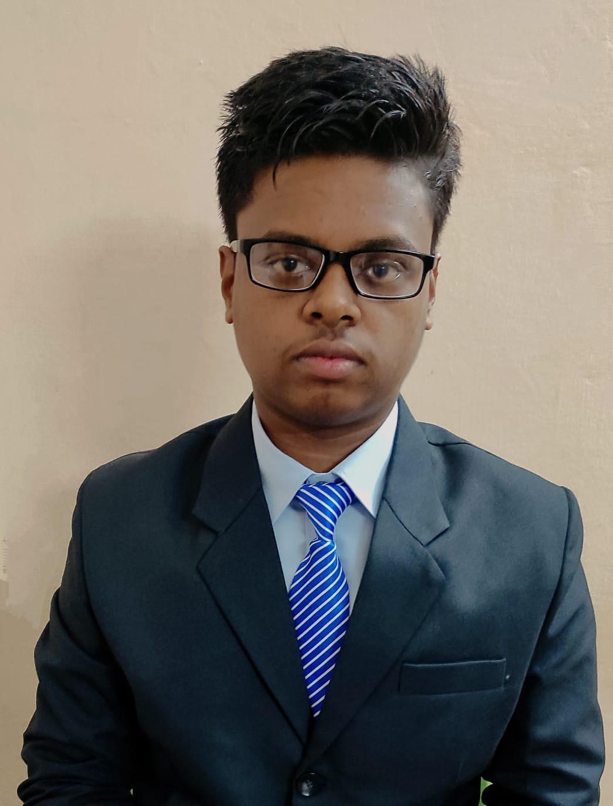
PREPARED BY:
URJASWI
ANKUR
AYUSH
SUBHASREE
ANIKET
AMAN

Slide 3
INTRODUCTION
Recommendation systems are a powerful tool that can be used to personalize the customer experience and increase engagement. In this capstone project, we will develop a recommendation system for a telecommunication company. The goal of the system is to suggest the next best offer to customers based on their past behavior and preferences.
We will use machine learning techniques to train the recommendation system. This will allow us to personalize the offers and promotions that are suggested to each customer. The company hopes that this will lead to increased revenue and customer satisfaction.

Slide 4
PROJECT OVERVIEW
The project will be divided into the following phases:
1.Data collection: We will collect data on customer behavior and preferences. This data will be used to train the recommendation system.
2.Model development: We will use machine learning techniques to develop a recommendation system.
3.Model evaluation: We will evaluate the performance of the recommendation system.
4.Deployment: We will deploy the recommendation system to production.

Slide 5
EXPECTED OUTCOMES:-
The expected outcomes of this project are:
1.A recommendation system that can personalize offers and promotions for customers.
2.Increased revenue and customer satisfaction for the telecommunication company.
3.A better understanding of how machine learning can be used to improve the customer experience.

Slide 6

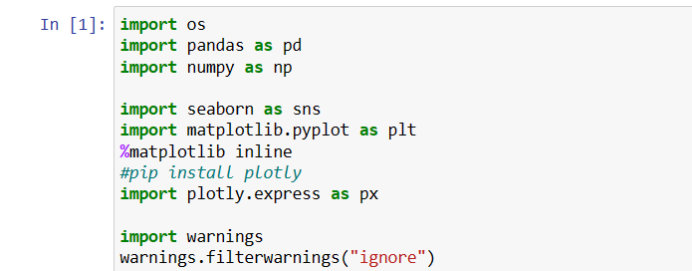
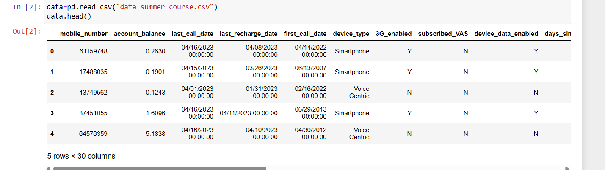
DATA MANIPULATION

Slide 7
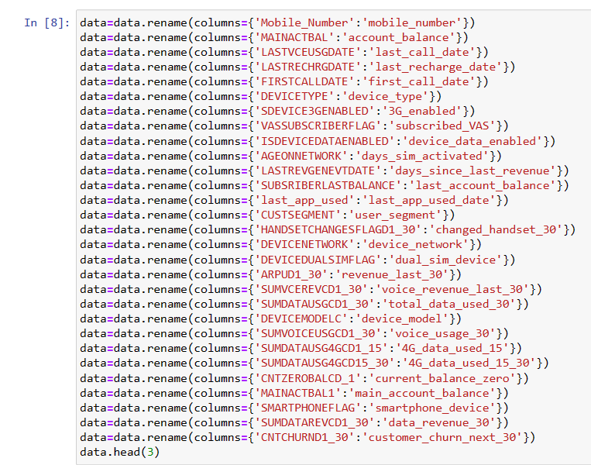

Slide 8
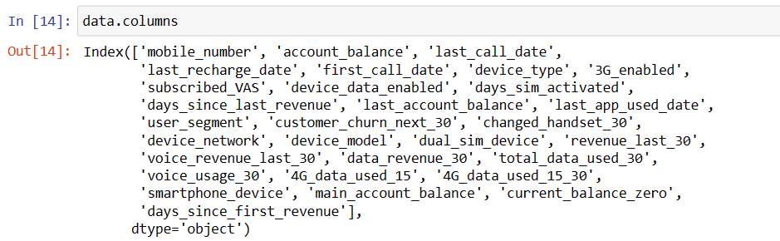

Slide 9
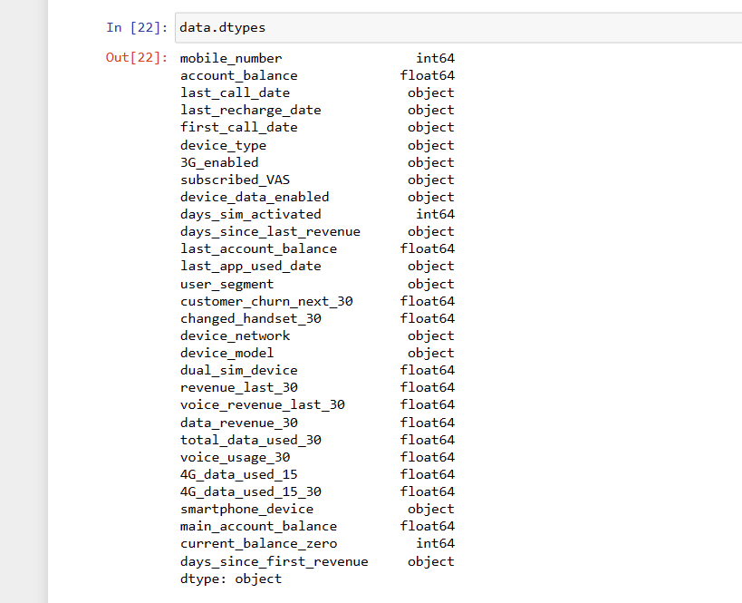

Slide 10
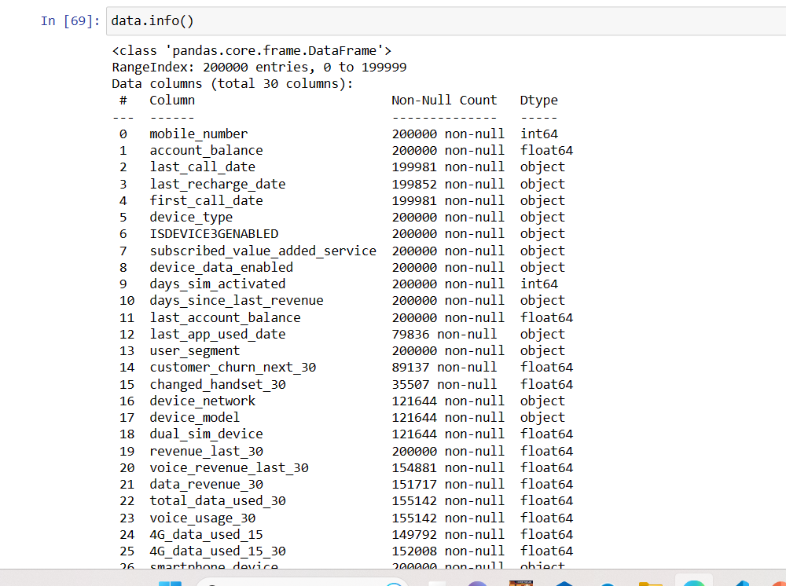

Slide 11
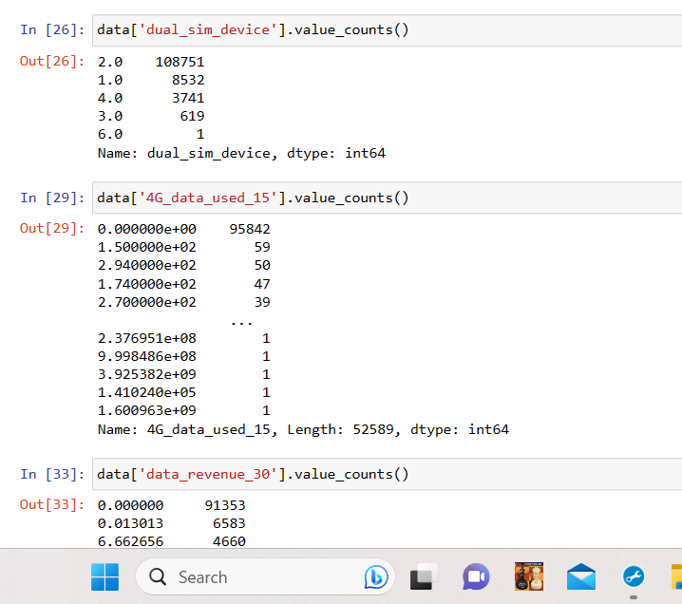

Slide 12
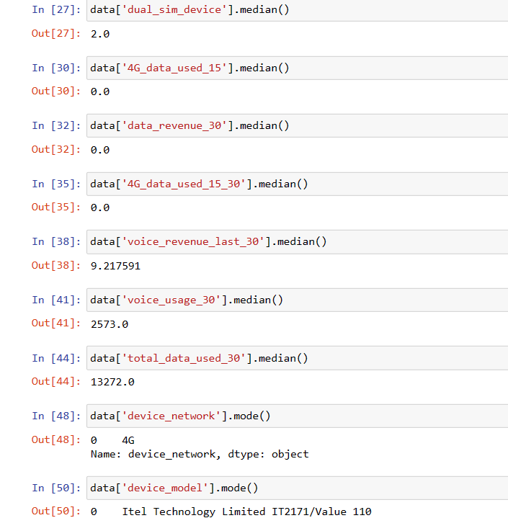
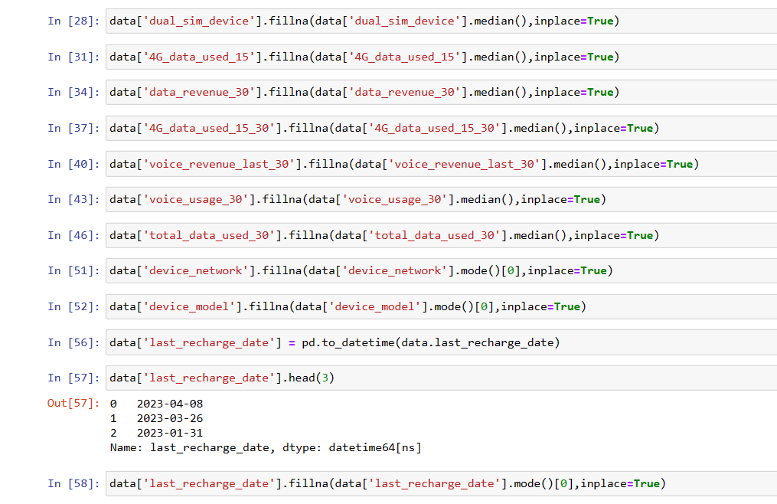

Slide 13
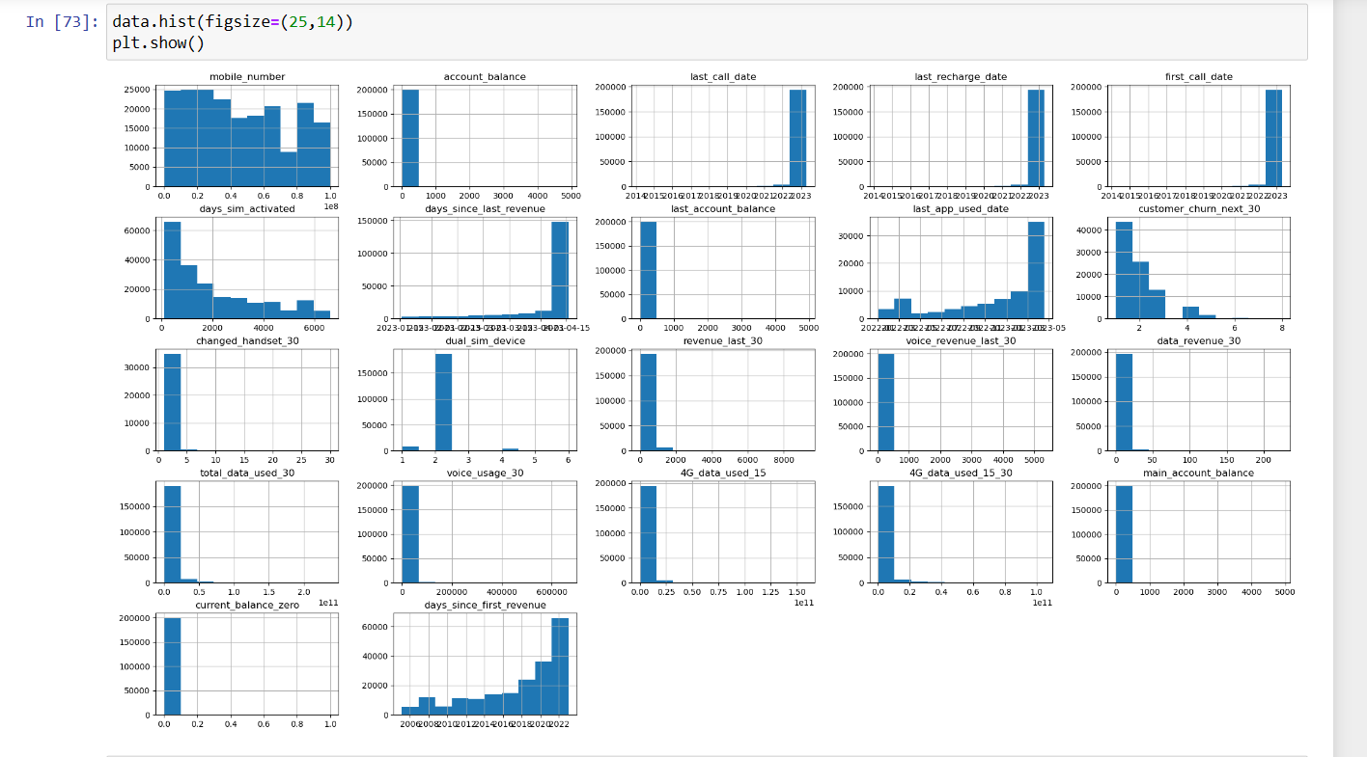
UNIVARIATE:-

Slide 14
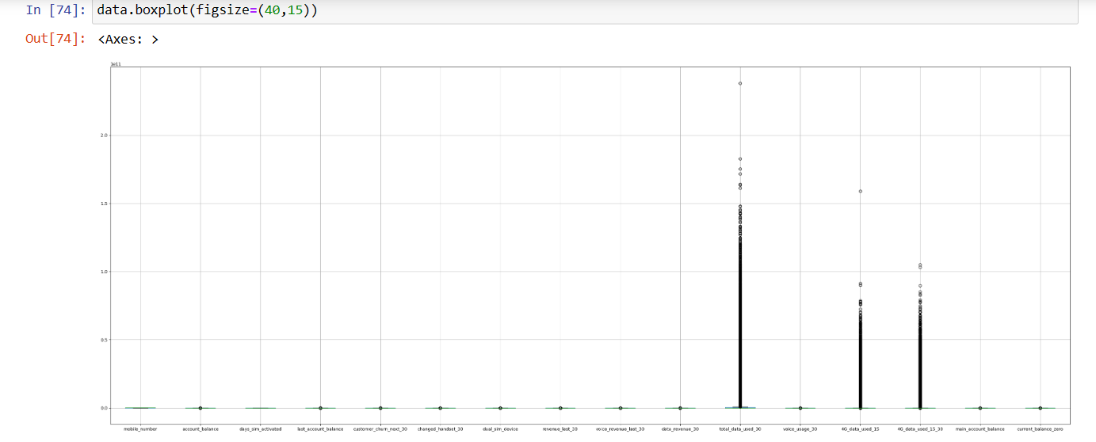
03
Name of
the section
You can enter a subtitle here if you need it

Slide 15
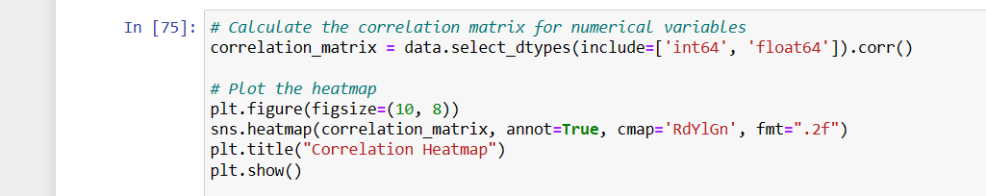
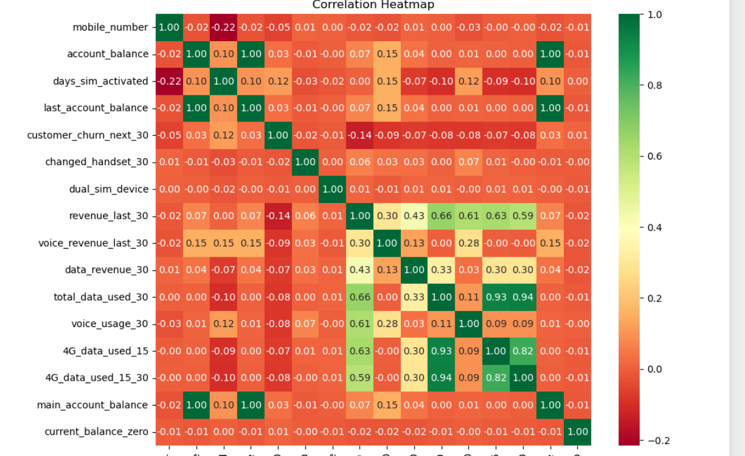
You can replace the image on the screen with your own work. Just right-click on it and select “Replace image”

Slide 16
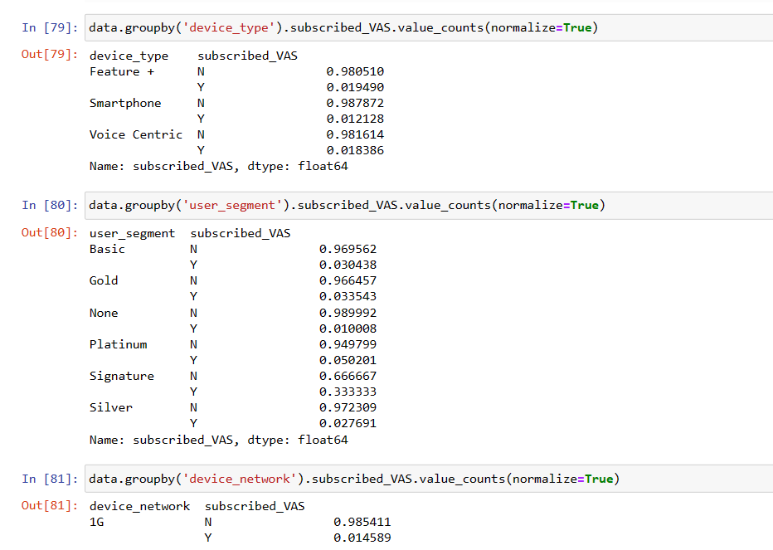

Slide 17
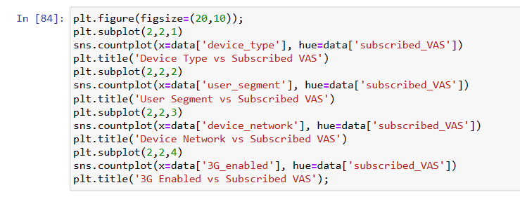
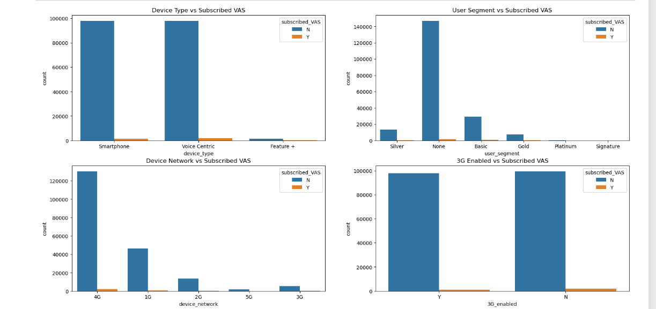
BIVARIATE:-

Slide 18
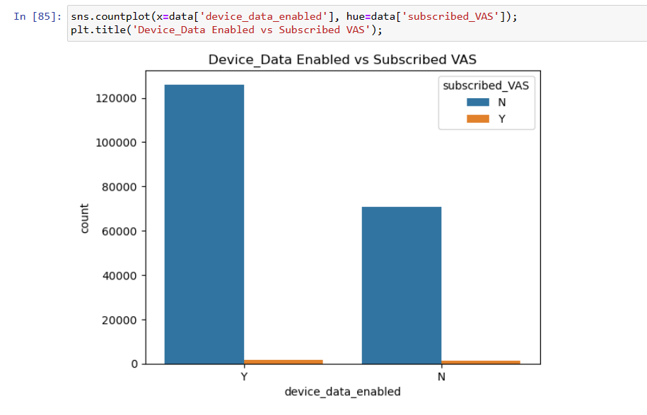
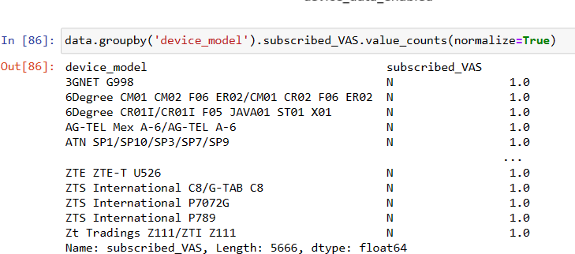

Slide 19
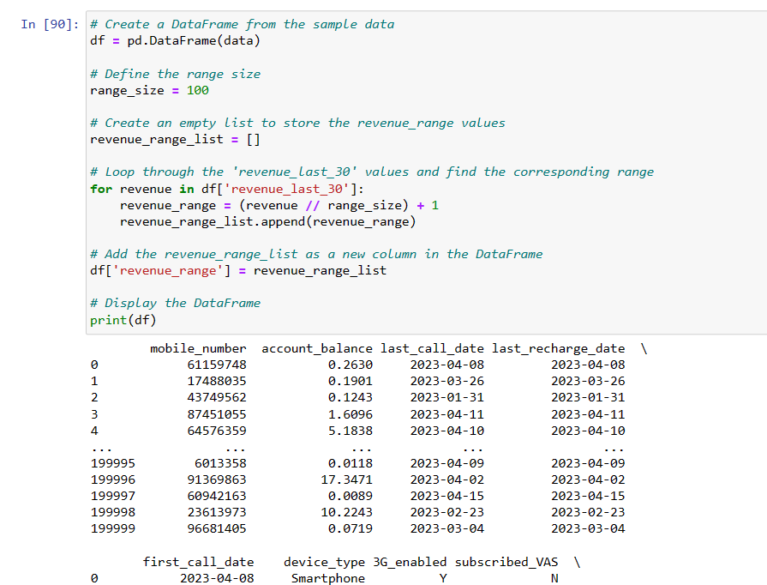

Slide 20
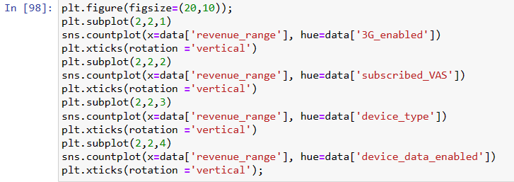
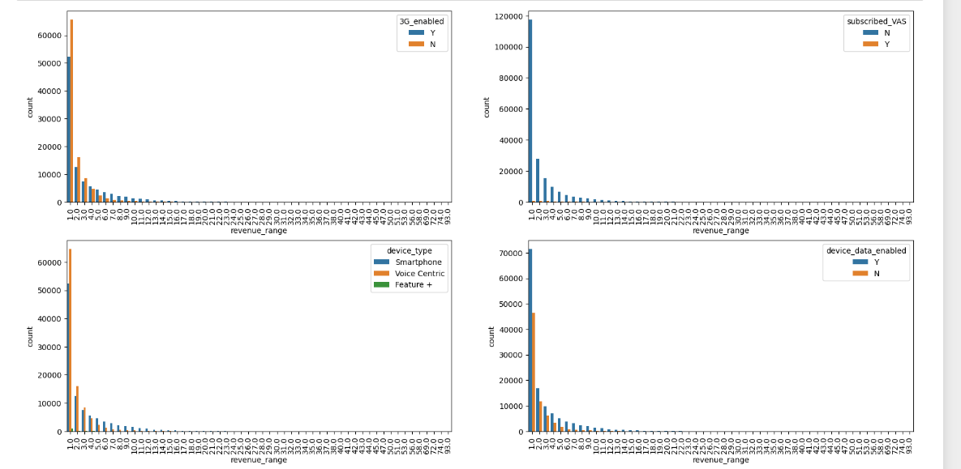

Slide 21
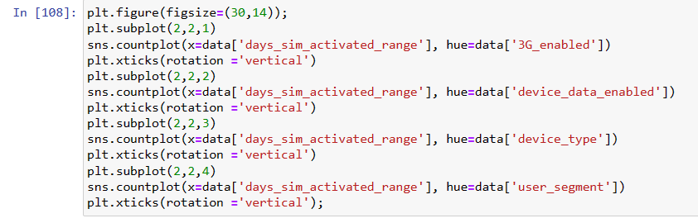
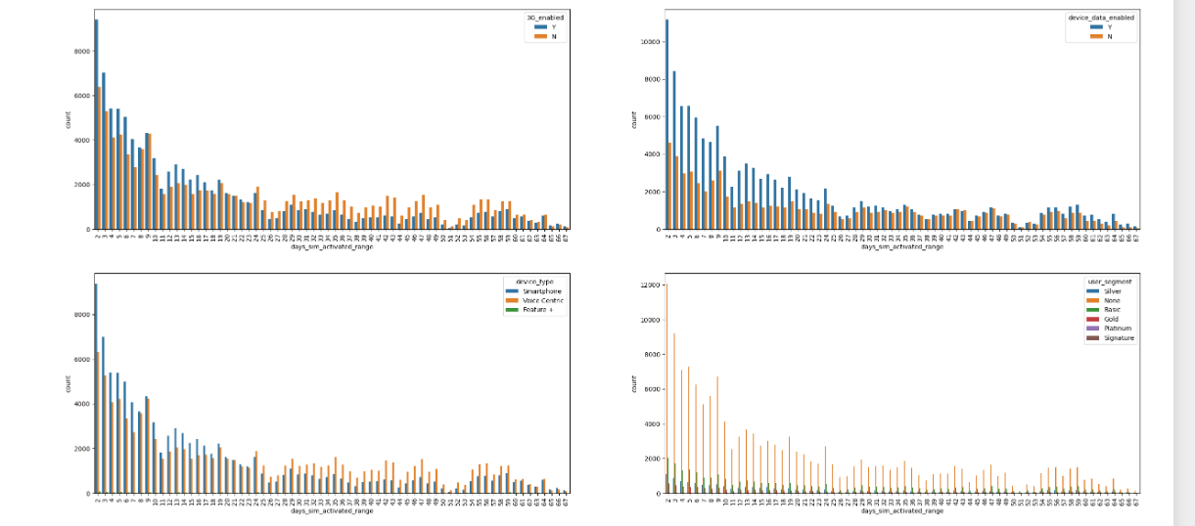

Slide 22
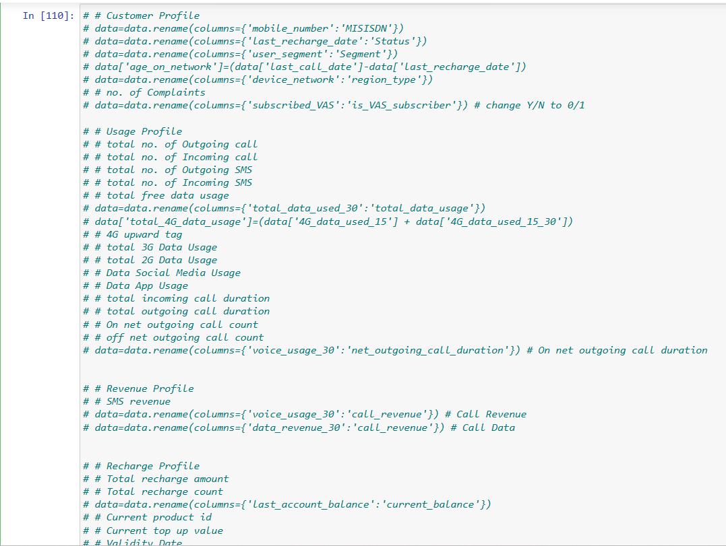

Slide 23
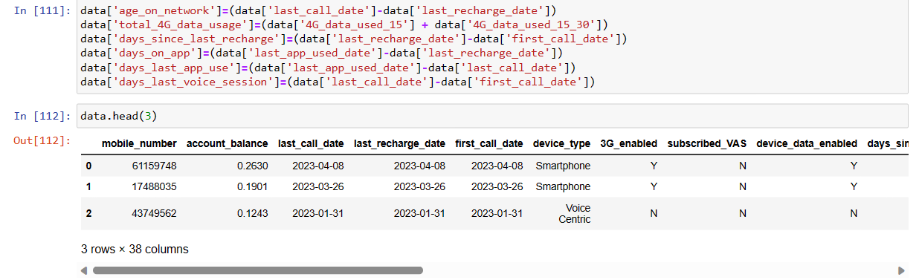

Slide 24
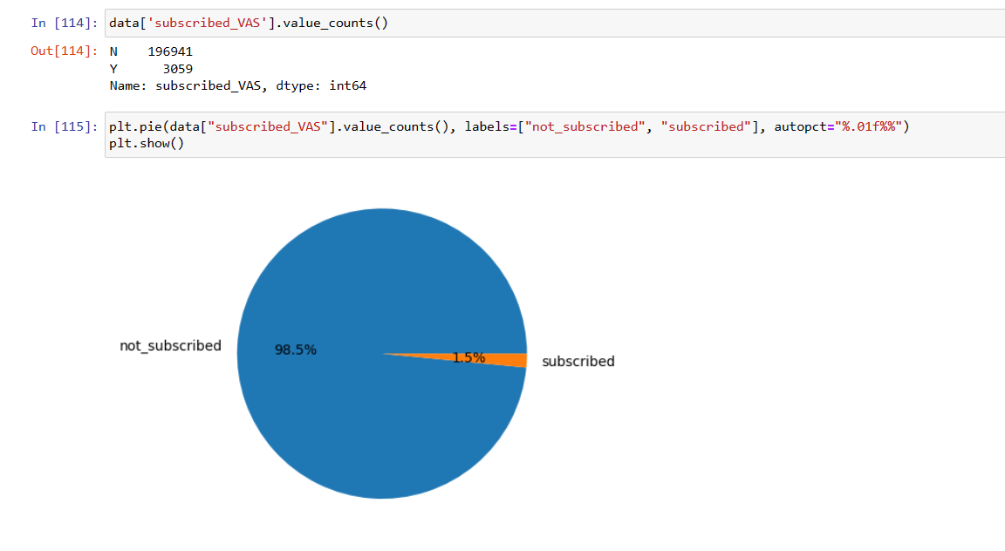

Slide 25
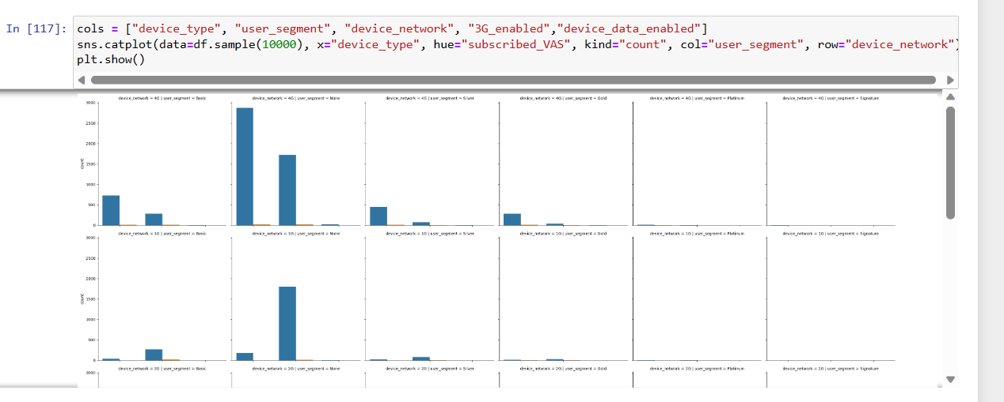

Slide 26
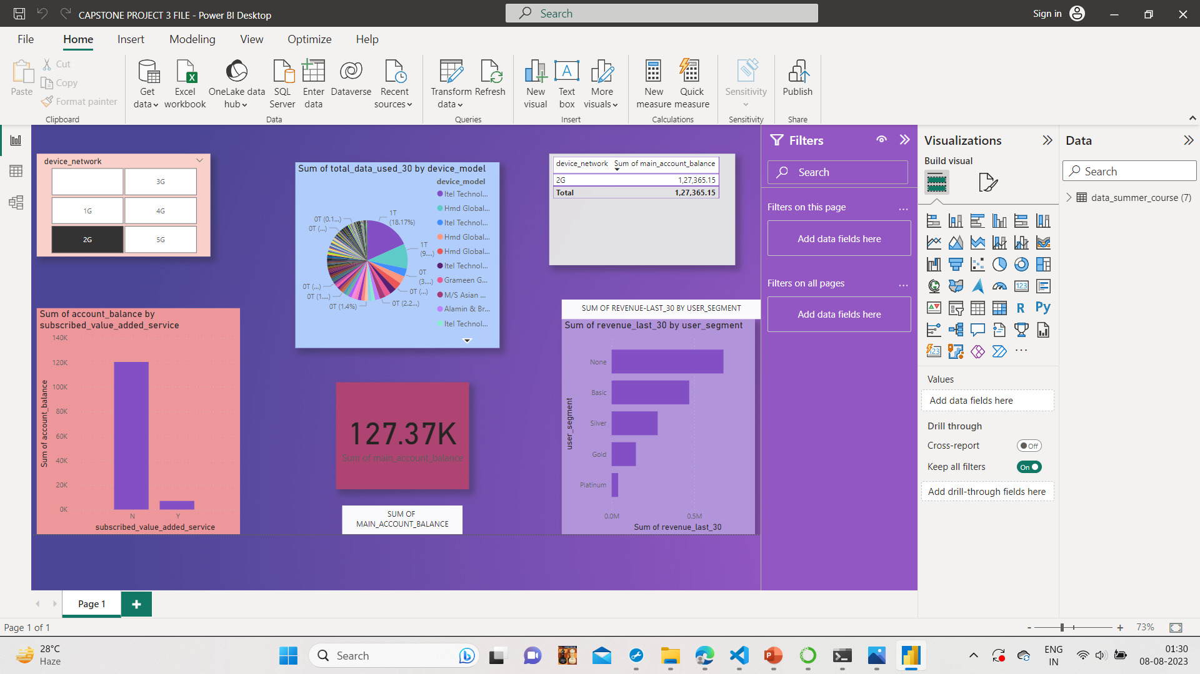

Slide 27
MODEL BUILDING USING K-MEANS

Slide 28
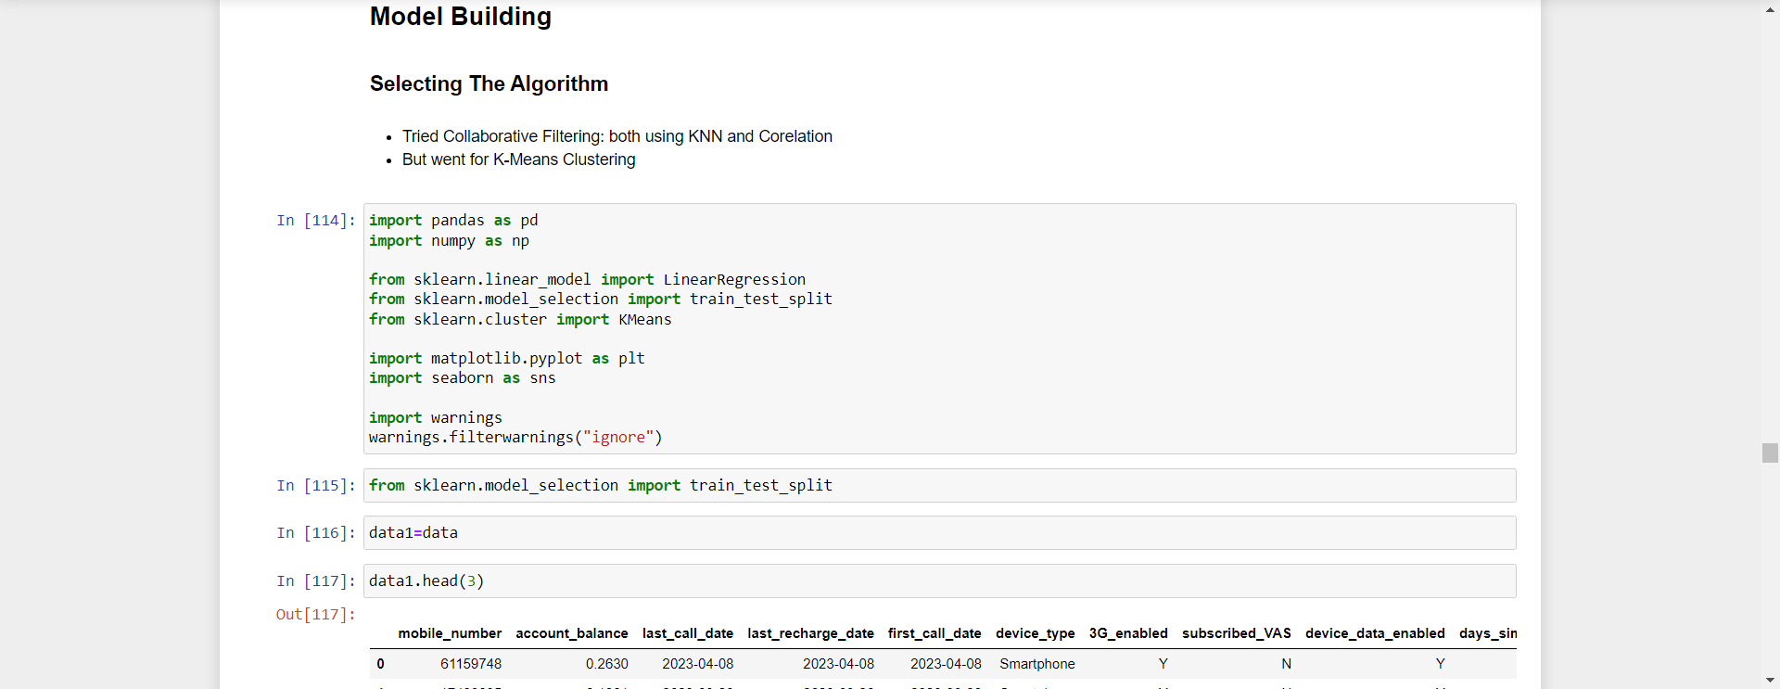
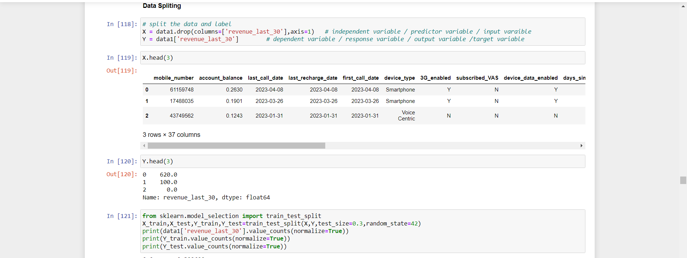

Slide 29
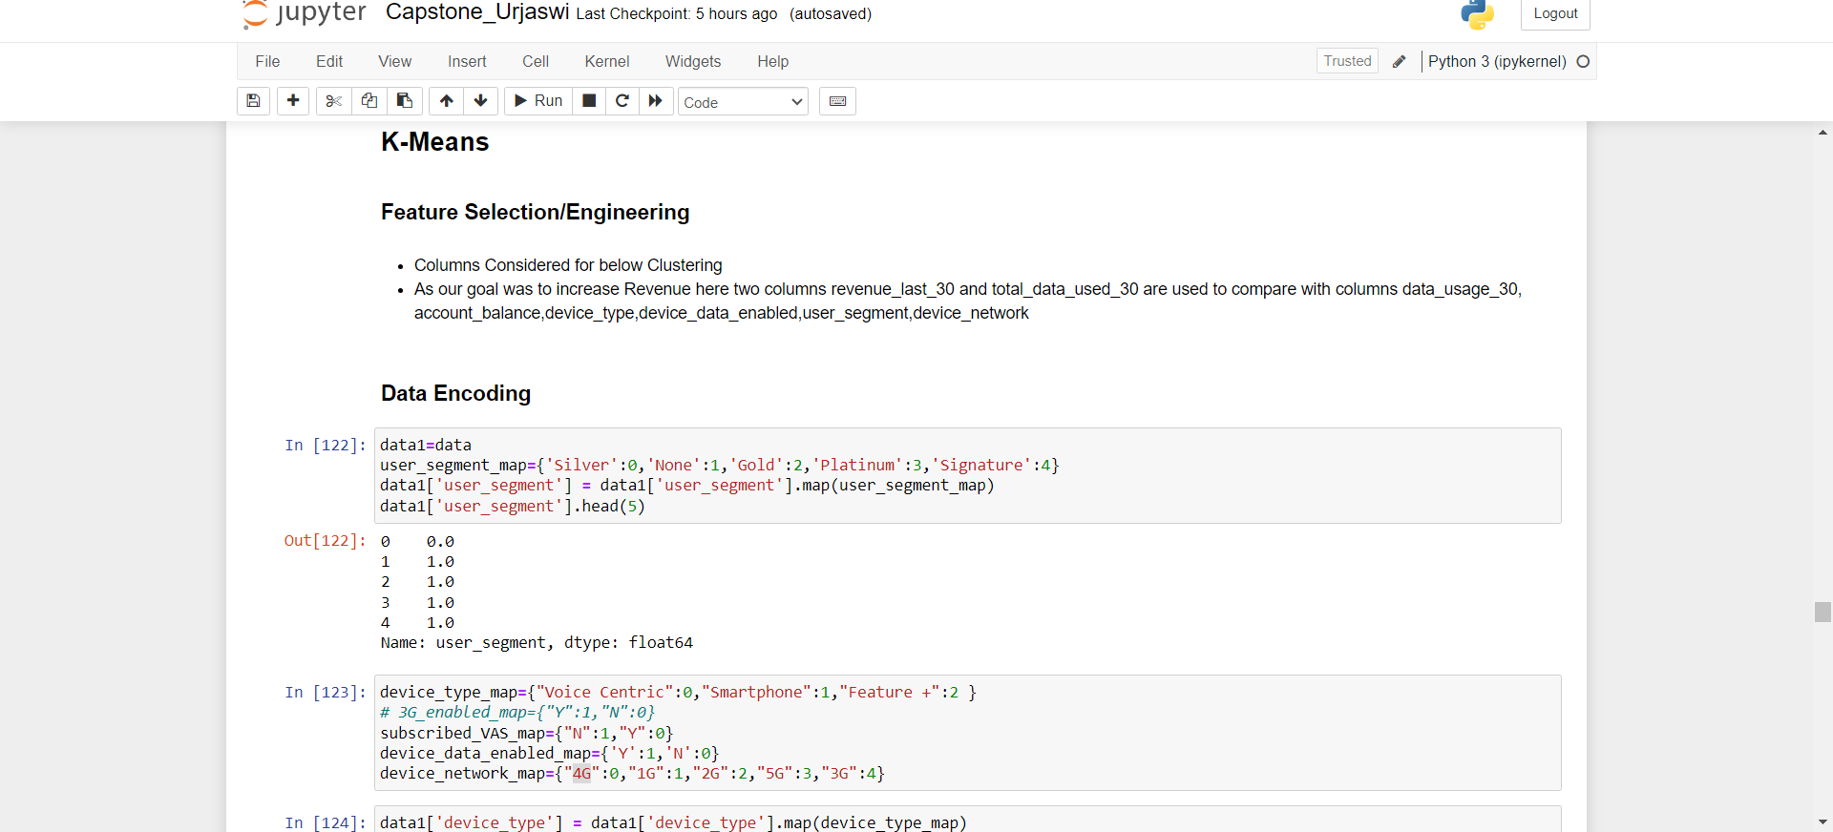
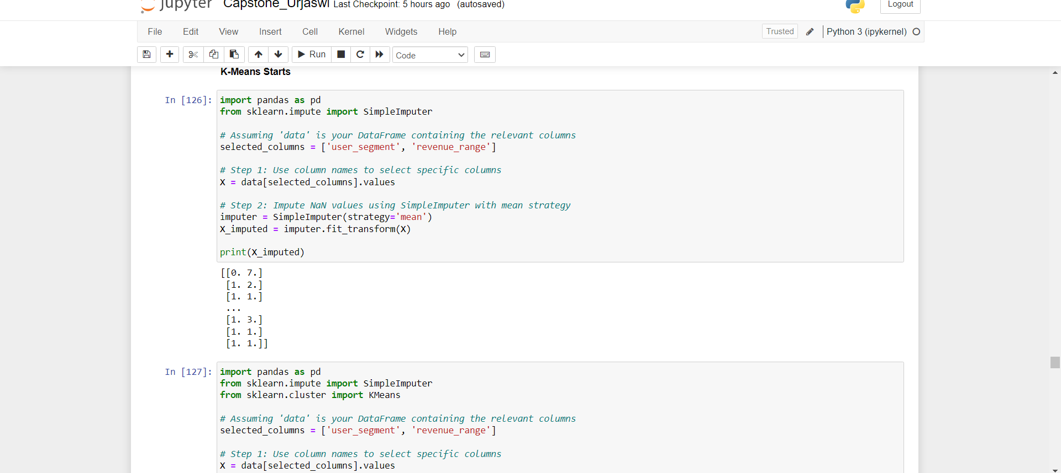

Slide 30
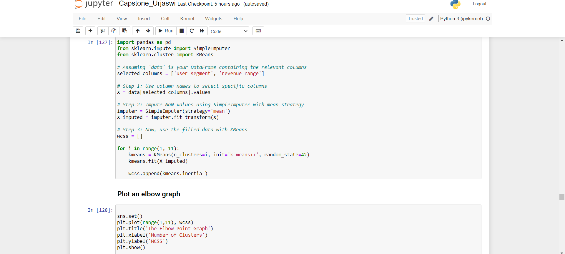
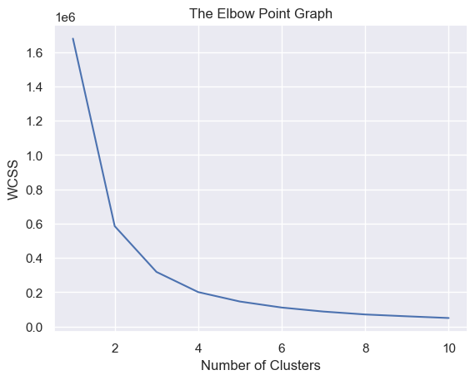

Slide 31
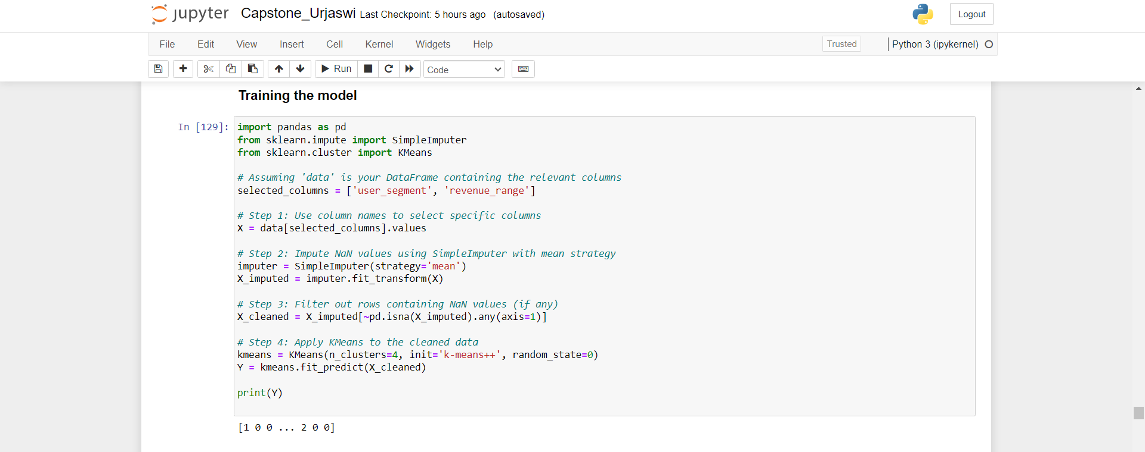

Slide 32
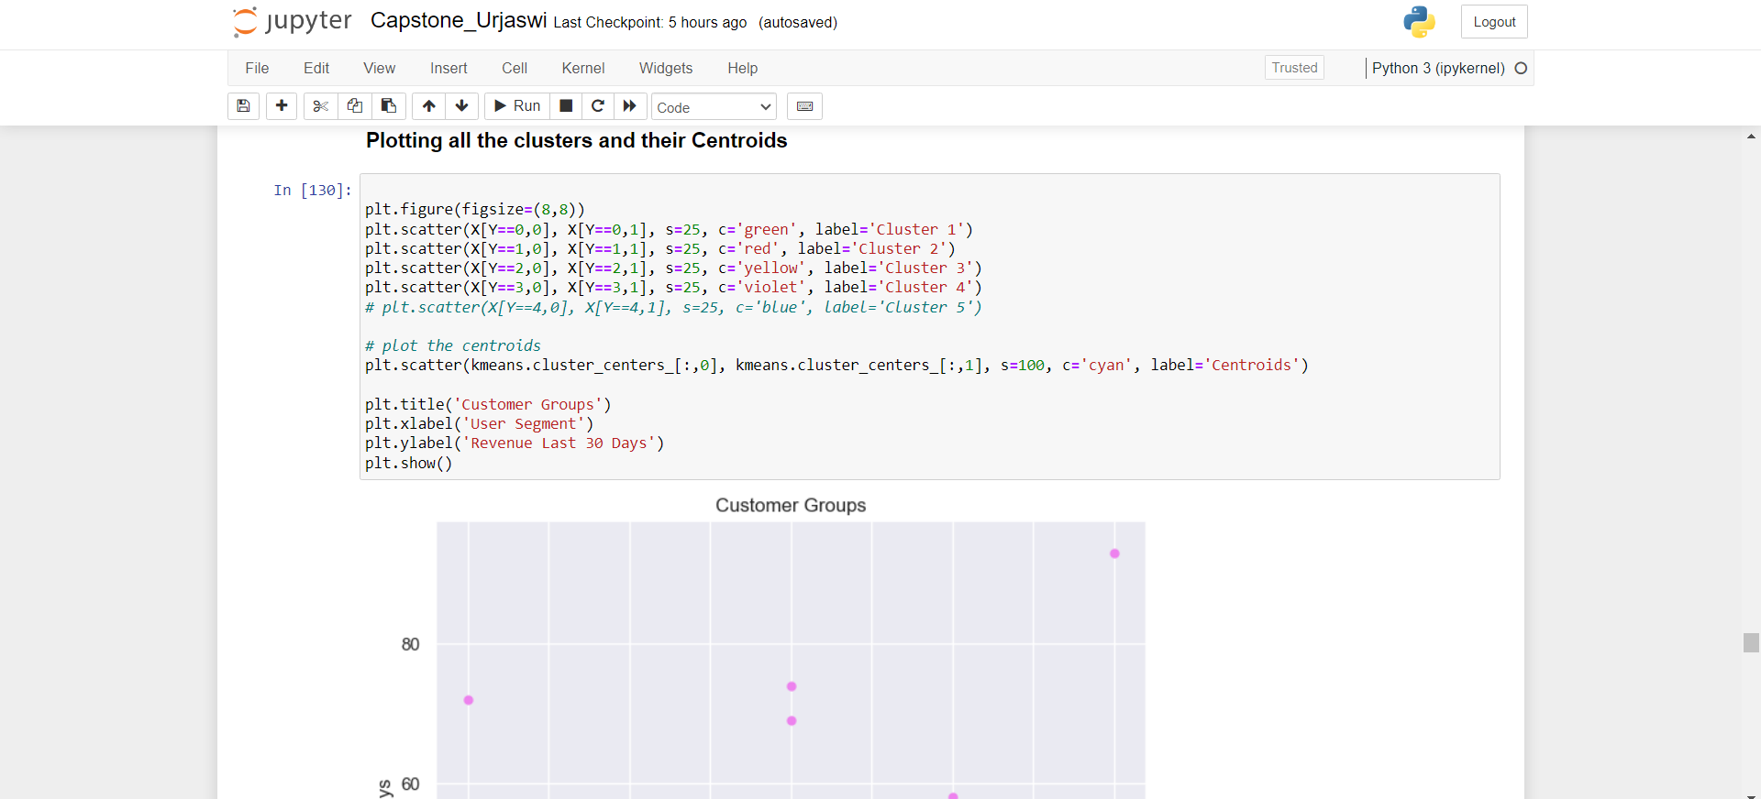
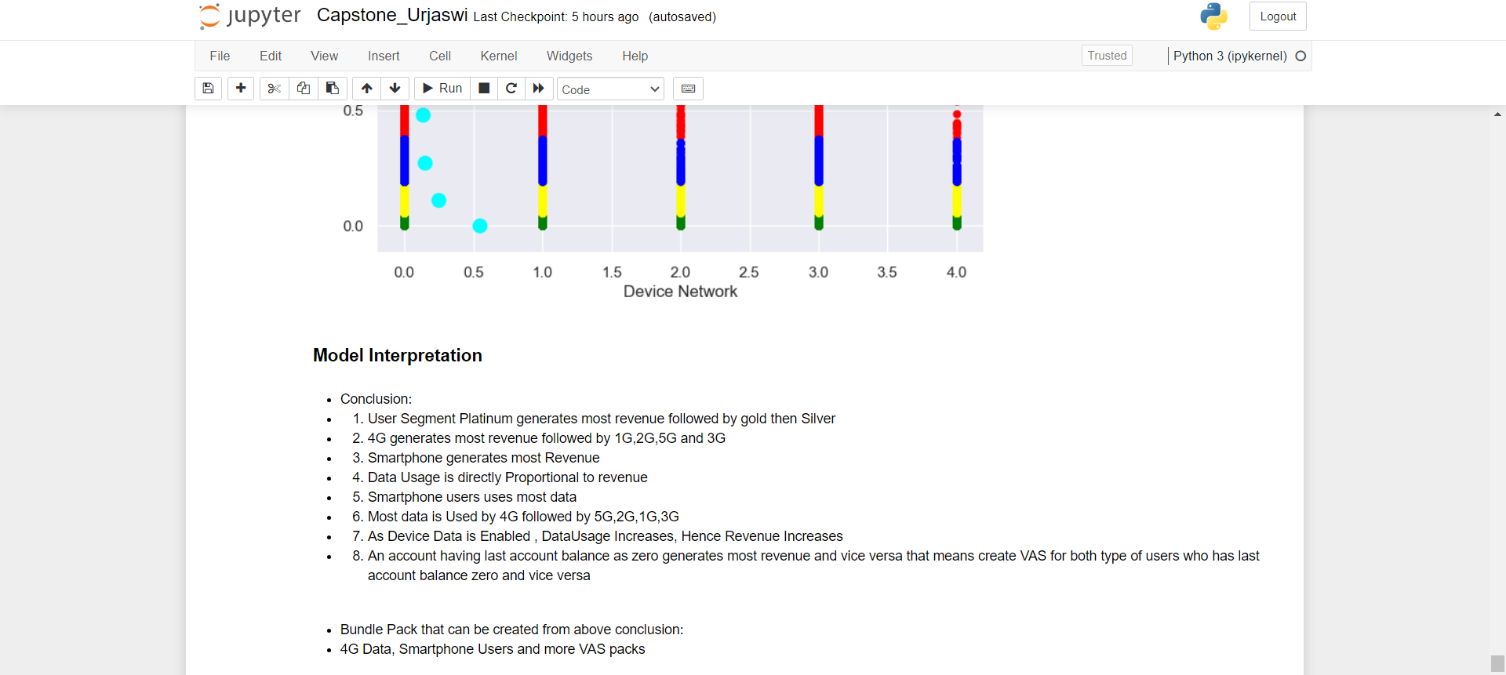

Slide 33
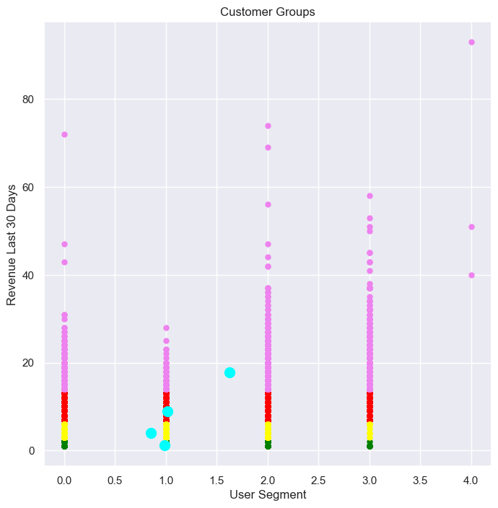
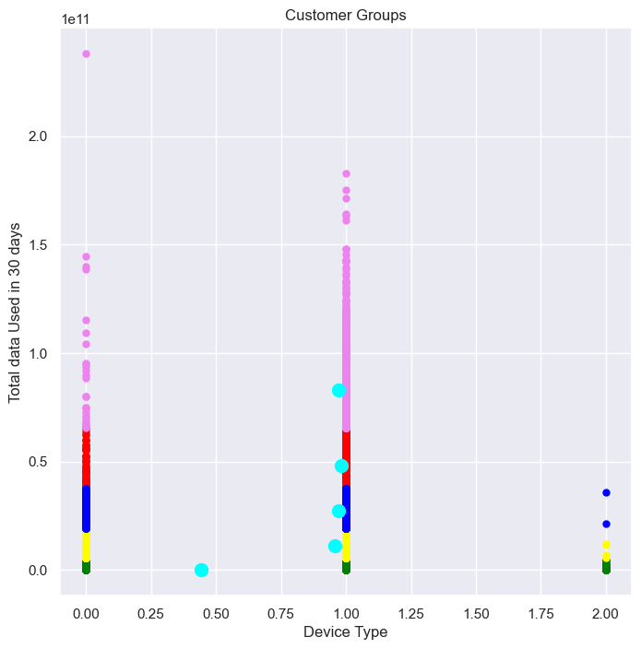
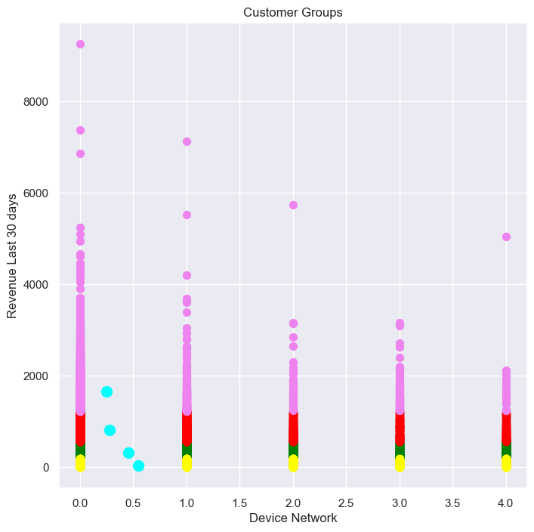
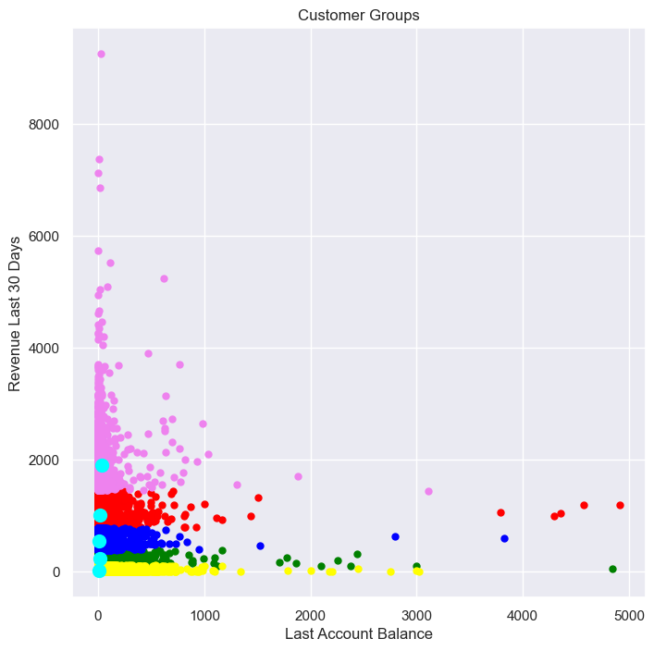
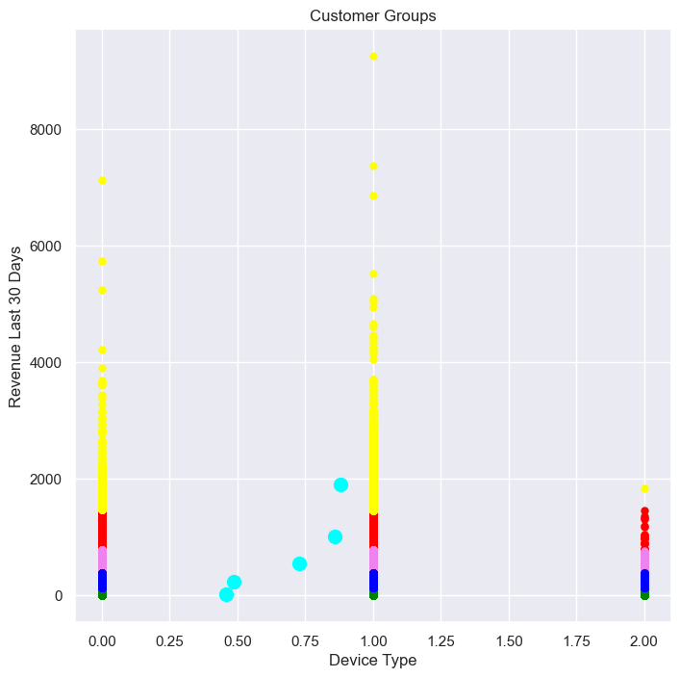
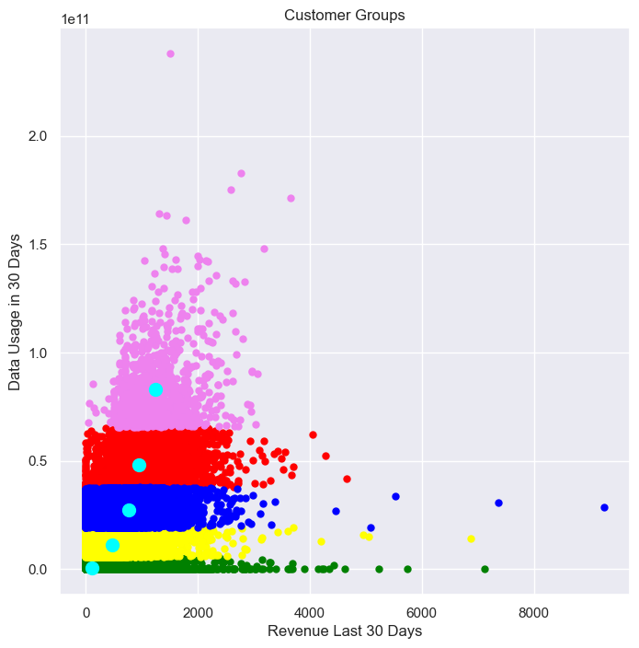

Slide 34
Columns Considered for above Clustering :
As our goal was to increase Revenue her two columns revenue_last_30 and total_data_used_30 are used to compare with columns data_usage_30, account_balance,device_type,device_data_enabled,user_segment,device_network.
Conclusion:
1. User Segment Platinum generates most revenue followed by gold then Silver
2. 4G generates most revenue followed by 1G,2G,5G and 3G
3. Smartphone generates most Revenue
4. Data Usage is directly Proportional to revenue
5. Smartphone users uses most data
6. Most data is Used by 4G followed by 5G,2G,1G,3G
7. As Device Data is Enabled , DataUsage Increases, Hence Revenue Increases
8. An account having last account balance as zero generates most revenue and vice versa that means create VAS for both type of users who has last account balance zero and vice versa
Bundle Pack that can be created from above conclusion:
4G Data, Smartphone Users and more VAS packs.

Slide 35
CONCLUSION:-
In this introduction, we have outlined the objective, project overview, and expected outcomes of this capstone project. We believe that this project has the potential to make a significant impact on the telecommunication company. We are excited to begin working on this project and we look forward to sharing our results with you.

Slide 36
THANK YOU

